Slide 1

Capstone Project: End-to-End Data Modeling for a Retail Analytics Platform
Retail
Presented By:
Sumit Kumar

Slide 2
Agenda
Conceptual Model
Logical Model
Physical Model with Indexing and Partitioning
ETL Process and Medallion Architecture
Data Governance and Quality Framework
Version Control & Schema Evolution
Problem Statement

Slide 3
Problem Statement
Retail businesses face challenges in optimizing inventory, predicting sales trends, personalizing customer experiences, and managing supplier performance due to fragmented data and lack of a unified analytics platform.
1
2
3
4
Data Integration
& Modeling
Advanced Analytics
& Reporting
ETL & Governance
Deployment
& Automation
Design an end-to-end scalable data model (conceptual → logical → physical) to unify data from POS systems, e-commerce, supplier databases, and customer feedback.
Enable sales forecasting, inventory optimization, and customer behavior analysis using a star schema in Databricks Delta.
Implement ETL pipelines for batch and real-time data, ensuring data quality, security, and compliance (GDPR).
Use Git for version control and Terraform to automate data warehouse deployment with schema versioning and rollback strategies.

Slide 4
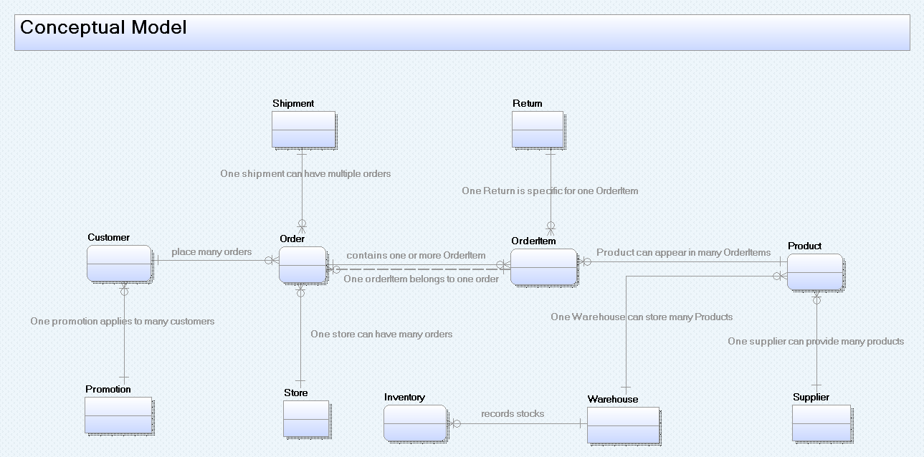
Conceptual Model
Customer-Centric
Customers place orders, serving as the foundation for tracking transactions and personalized marketing.
Order Lifecycle Tracking
Orders link to multiple order items, shipments, and returns, enabling complete sales lifecycle management.
Product as a Core Entity
Products connect to order items, promotions, suppliers, warehouses, and inventory for comprehensive product management.
Multi-Channel Sales Support
Inclusion of Stores and Channels supports omnichannel retailing and inventory tracking.
Cardinality and Business Rules
Inventory & Warehouse Tracking
One customer places many orders
One order contains multiple order items
One shipment can cover multiple orders
Returns are specific to individual order items
One product can be stored in multiple warehouses
Warehouses store products and inventory records stock levels for effective inventory control.
Supplier & Promotion Integration
Suppliers provide products, and promotions apply to customers for operational and marketing insights.

Slide 5
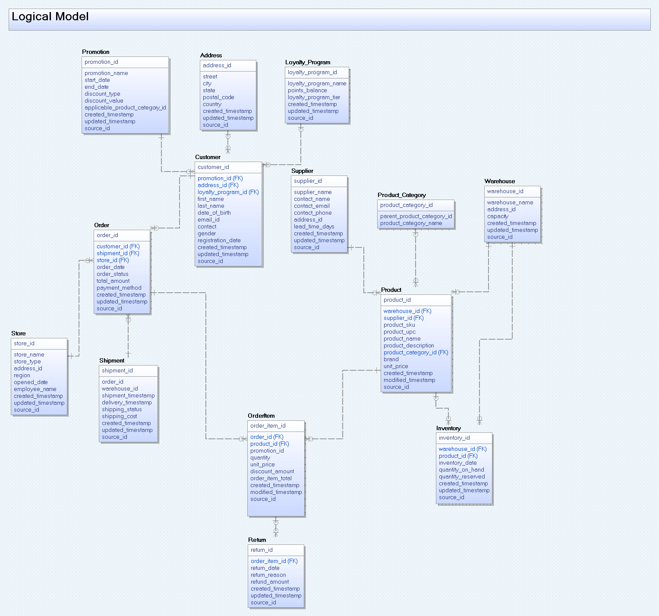
Logical Model

Slide 6
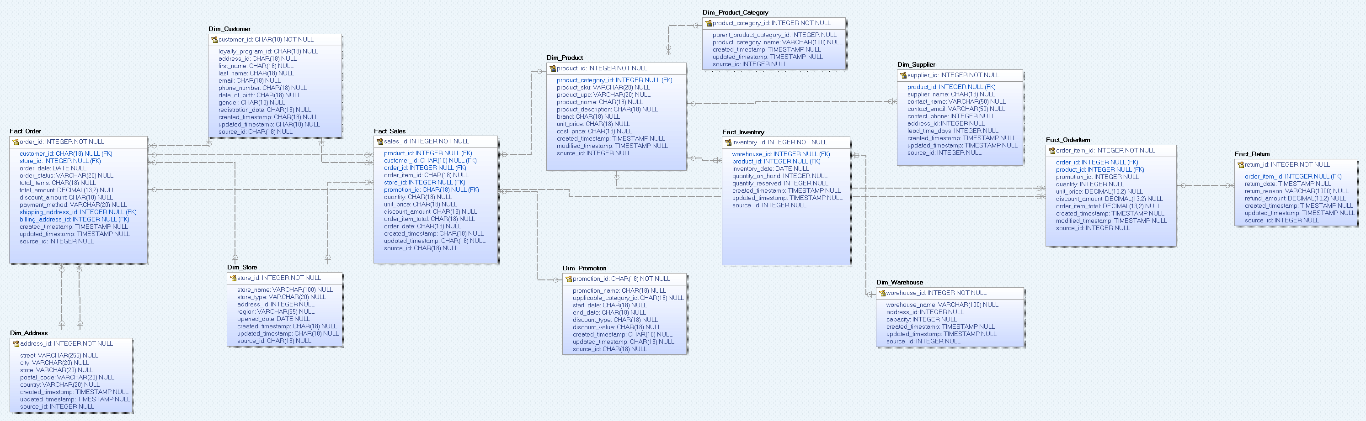
Physical Model

Slide 7
Explanation of Physical Data Model
The model supports efficient querying and reporting for retail analytics, focusing on sales performance, customer behavior, promotion effectiveness, and inventory management.
Fact Tables
Dimension Tables
Design Features & Data Integrity
Capture key transactional events and measurable metrics.
Examples:
Fact_Sales: Records sales transactions, linking to customers, products, orders, promotions, and stores.
Fact_Order: Contains order-level data with customer and store references.
Fact_Inventory: Tracks inventory status by product and warehouse.
Foreign keys in fact tables link to dimensions for context.
Support detailed analytics on sales, orders, and inventory movement.
Store descriptive attributes to provide context for facts.
Examples:
Dim_Customer: Customer profiles including loyalty details.
Dim_Product: Product details with category linkage.
Dim_Store, Dim_Warehouse, Dim_Supplier: Capture geography, supply chain, and sourcing info.
Dim_Promotion: Contains promotion campaign details.
Dim_Address: Normalizes addresses used for stores and customers.
Enable slicing and dicing of data for versatile analytics.
Referential integrity enforced via foreign keys for reliable joins.
Includes audit timestamps (created, updated) to track data changes and history.
Supports scalable performance via clear separation of facts and dimensions.
Designed to optimize query efficiency for retail analytics use cases like sales trends, inventory control, and customer behavior insights.

Slide 8
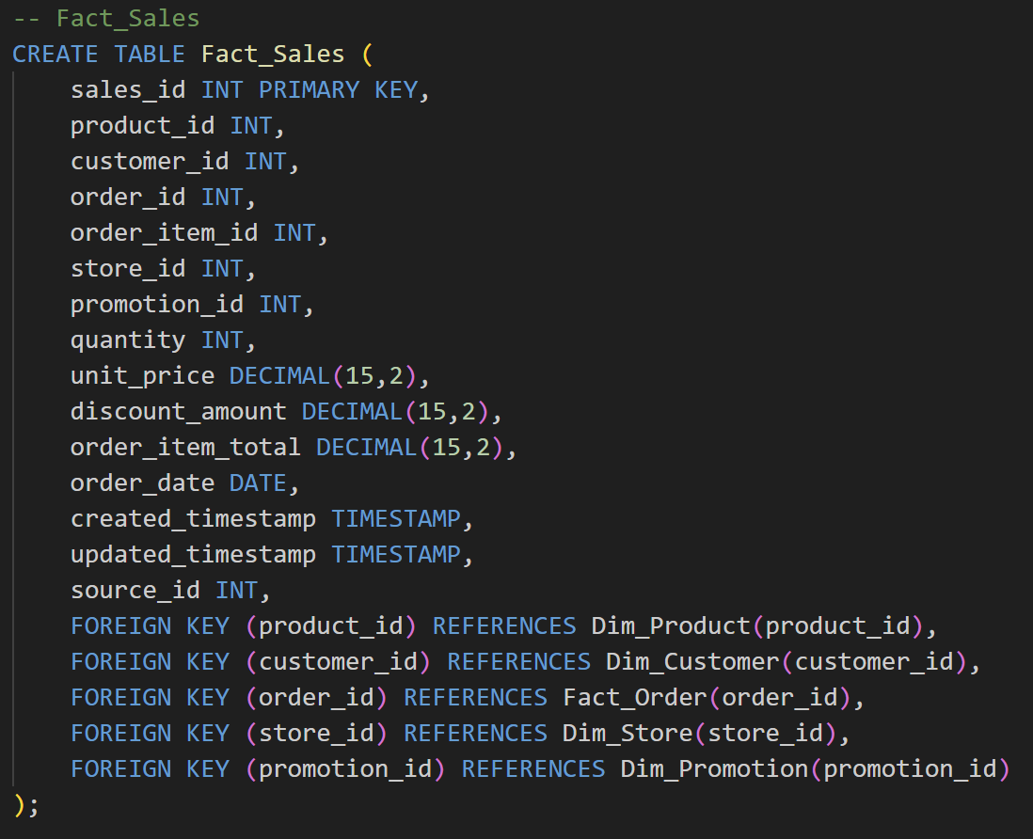
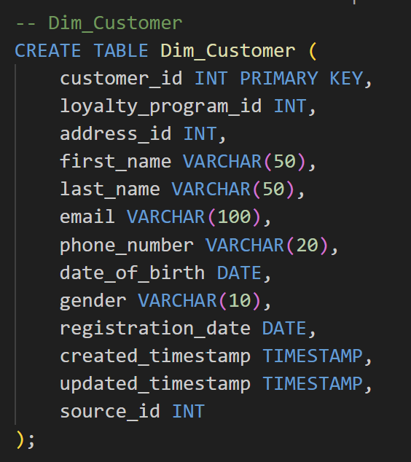
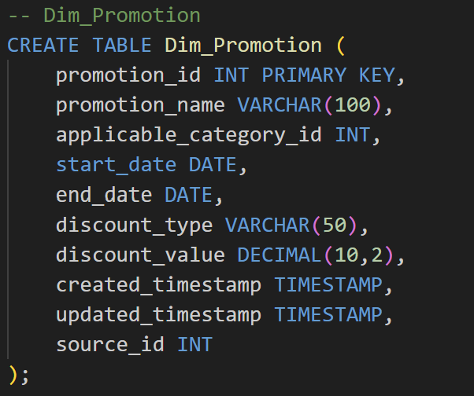
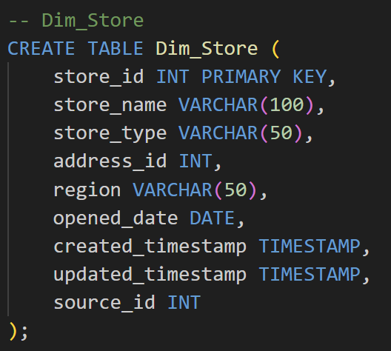
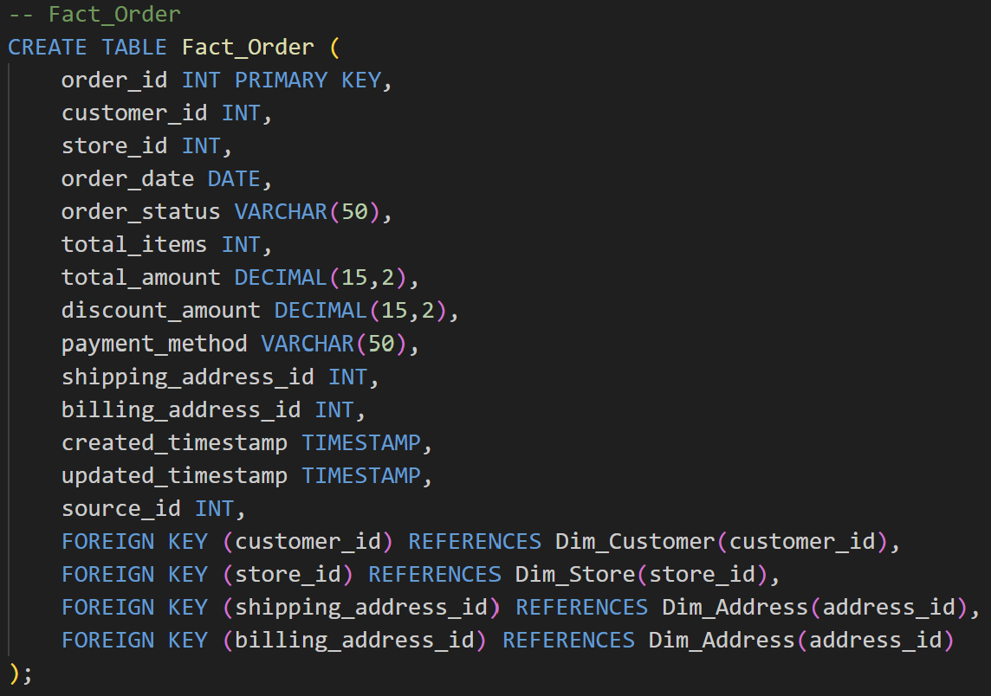
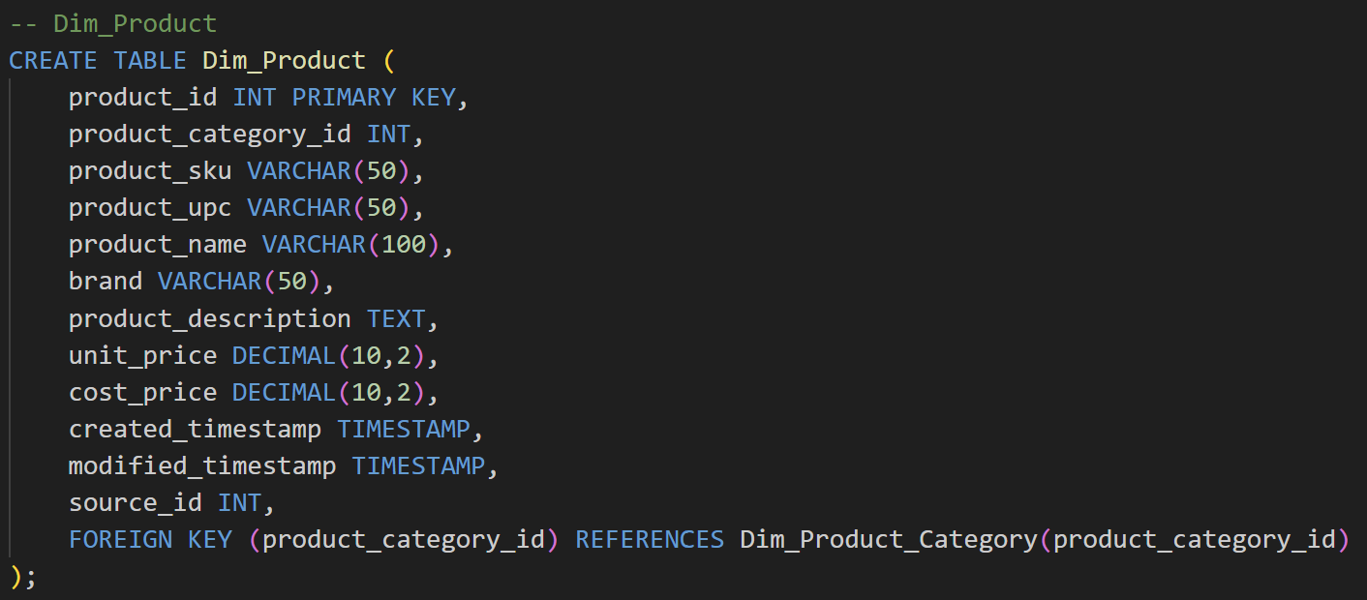
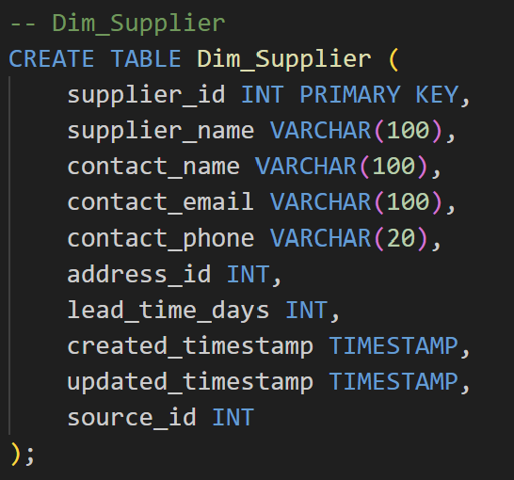
Physical Model (SQL)

Slide 9
Physical Model (Indexing and Partitioning )
Table | Purpose | Indexing | Partitioning
Fact_Order | Captures order headers including customer, store, payment, and totals | PK: order_id Index: customer_id, store_id | Partition by order_date
Fact_Sales | Stores sales transactions linking customers, products, promotions, and stores | PK: sales_id Z-Order: product_id, customer_id, store_id | Partition by order_date
Fact_Inventory | Records inventory levels and reservations per warehouse and product | PK: inventory_id Z-Order: warehouse_id, product_id | Partition by inventory_date
Fact_OrderItem | Records details of individual items within an order | PK: order_item_id Index: order_date, product_id | Partition by order_date
Dim_Customer | Stores customer profile, loyalty, and contact information for personalization & segmentation | Primary Key: customer_id | None
Dim_Promotion | Stores promotion campaign details applied to sales transactions and customers | Primary Key: promotion_id Recommended Z-Order on start_date, end_date for efficient filtering by promotion period | Optional: Partition by start_date or year(start_date) if table is large and queries often filter by promotion period
Dim_Product | Maintains product catalog linked with categories and suppliers for sales and inventory management | PK: product_id Optional Z-Order: product_category_id | Optional: product_category_id (if large)
Dim_Supplier | Contains supplier details for inventory sourcing and lead times | Primary Key: supplier_id | None
Dim_Warehouse | Stores warehouse capacity, location, and operational metadata | Primary Key: warehouse_id | Optional: region/location if large
Dim_Store | Contains store metadata used in transactions and sales reporting | Primary Key: store_id | Optional: region/location if large
Dim_PaymentMethod | Contains payment options usable in customer orders | Primary Key: payment_method_id | None
Fact_Return | Tracks product returns linked to an order | ReturnID (PK), OrderID | Optional: ReturnDate

Slide 10
ETL Process
Extract
In-store POS systems
E-commerce platforms
Transform
Clean the raw data
Load
Aggregate and enrich the cleansed data to derive business insights.
Warehouse management systems
Customer feedbacks
Transform the raw data
Validate the data
Supports complex analytics, BI dashboards and reporting, and machine learning applications
Supplier databases
Notes:
Extract : Ingest raw data into Databricks Delta Lake, which ensures ACID (Atomicity, Consistency, Isolation, and Durability), transactions, scalable metadata handling, and data versioning
Tranform : This involves applying schema validation, removing duplicates, and other necessary data cleansing processes. Reduce data storage complexity, latency and redundancy also optimizes the ETL throughput and analytic query performance
Load : Optimizes query performance for business-level and reduce strain on production system.

Slide 11
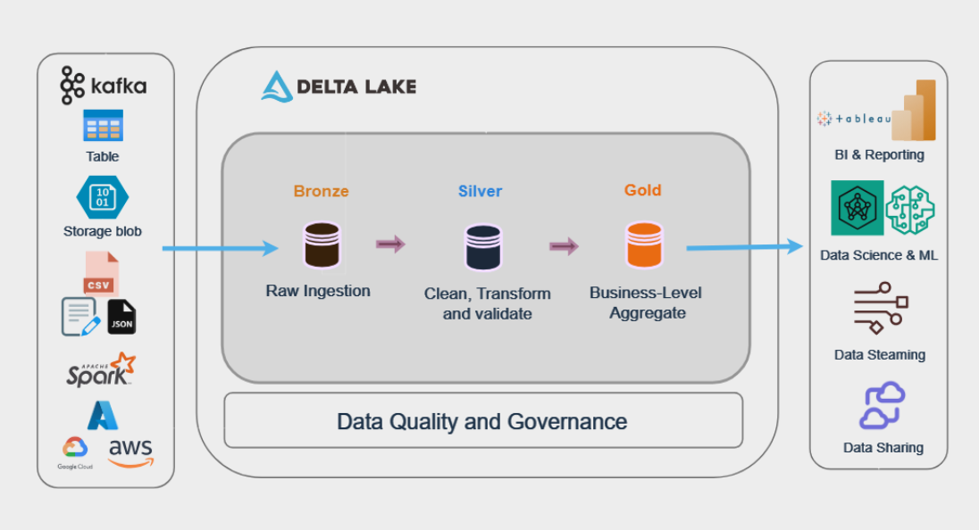
Overview of the Medallion Architecture

Slide 12
Data Governance & Data Quality
Data Governance ensures proper management and security of data, while Data Quality ensures its accuracy, consistency, and reliability.
Data Quality Rules & Validation
Data Governance Policies
Metadata & Lineage Management
Schema-level Constraints –
Enforce NOT NULL, CHECK, and referential integrity in Delta tables (e.g., non-negative quantities, valid dates).
Deduplication –
Apply MERGE logic in ETL to eliminate duplicate customers, orders, and product entries before loading into fact tables.
Data Profiling & Validation Scripts –
Regularly run Databricks jobs to check for missing values, out-of-range values, or inconsistent formats.
Access Control & Security –
Implement role-based access in Databricks Unity Catalog to restrict sensitive data (e.g., customer PII)
Compliance Management –
Ensure GDPR compliance with masking or tokenization of personal data in reporting tables.
Data Ownership –
Define data stewards for each domain (Sales, Inventory, Supplier) to approve schema changes and validate quality.
Metadata Repository –
Store table descriptions, column definitions, and business rules in Unity Catalog or an external metadata tool.
Data Lineage Tracking –
Use Delta’s transaction log to trace data transformations from raw ingestion to analytics tables.
Change History –
Maintain Slowly Changing Dimensions (SCD) in dimension tables to preserve historical context for analytics.

Slide 13
Deployment - Version Control & Schema Evolution
Schema Versioning Strategy
All DDL scripts and data model artefacts (ERDs, mappings) are maintained in Git.
Each schema change is treated as a versioned commit, with a unique change_id and description.
Adopted semantic versioning approach:
V1.0 → Initial model release
V1.1 → Minor changes (add column, adjust datatype)
Change Review & Governance
Developers create feature branches for schema changes.
Pull Requests (PRs) used to:
Review design changes
Conduct peer validation
Attach business justification
Approval by the data governance lead before the merge
Change Log Metadata (Example Format)
Version | Date | Change Summary | Owner | Reviewer
1.0 | 25-Jul-2025 | Initial schema design | You | Lead A
1.1 | 30-Jul-2025 | Added one attribute to Customer | You | Peer B

Slide 14
Our Team
Sumit Kumar
Associate Manager – Data Engineering

